Slide 1

RESUME PARSING USING NLP (SpaCy NER)
GROUP 1

Slide 2

52% of Talent Acquisition leaders say the hardest part of recruitment is screening candidates from a large applicant pool.
Manually screening resumes is still the most time-consuming part of recruiting, especially when 75% to 88% of the resumes received for a role are unqualified. Screening resumes and shortlisting candidates to interview is estimated to take 23 hours of a recruiter’s time for a single hire.
-- AI For Recruiting, Ideal.com

Slide 3

PROJECT INTRODUCTION
Recruiting the right talent is crucial for any organization's success. However, with a large volume of resumes received for each job posting, it can be a time-consuming and overwhelming task for recruiters and hiring managers to manually sift through each one.
This project aims to simplify and streamline the resume screening process by building a resume parser application using Spacy's Named Entity Recognition (NER) module.

Slide 4



BUSINESS PROBLEM
TIME & RESOURCE INTENSIVE
The recruitment process can be time-consuming and resource-intensive, particularly when it comes to manually screening and evaluating large numbers of resumes, potentially delaying time-to-hire and increasing cost of hiring.
HUMAN ERROR
Manual extraction of information from resumes, such as the candidate’s education, experience, skills, etc. can be prone to human errors, potentially leading to missed opportunities to identify top talent.
NEED FOR AUTOMATION
The need for an automated solution to accurately identify and extract key entities such as name, education, experience, skills, etc. from resumes is essential.

Slide 5
What is Named Entity Recognition (NER)?
Named Entity Recognition (NER) is a technique in natural language processing (NLP) that involves identifying and extracting named entities from unstructured or semi-structured text. Named entities refer to real-world objects or concepts that have a name, such as people, organizations, locations, dates, times, currencies etc.
In the context of resume parsing, NER can be used to automatically extract key information from resumes, such as the candidate's name, location, experience, skills, and more. This can save recruiters and hiring managers valuable time and improve the efficiency of the recruitment process.
Python’s SpaCy NER module is a popular and powerful tool for implementing NER in NLP applications. The module can be trained on specific domains or datasets to improve its accuracy and performance.

Slide 6
Why SpaCy NER?
HIGH ACCURACY
SpaCy NER is known for its high accuracy and robust performance, making it a reliable choice for extracting important information from resumes
PRE-TRAINED MODELS
CUSTOMIZATION
SpaCy comes with pre-trained models for a variety of languages, including English, which can be easily fine-tuned for specific tasks such as resume parsing
SpaCy allows for easy customization of its models and training data, making it a flexible choice for building customized resume parsers.
SPEED
SpaCy NER is known for its speed and efficiency, allowing for fast and accurate parsing of large volumes of resumes

Slide 7

DATA COLLECTION & ANNOTATION
In this project, For the purpose of training, 220 resumes were downloaded from an online jobs platform. These documents were uploaded to Dataturks online annotation tool and manually annotated. The tool automatically parses the documents and allows for us to create annotations of important entities we are interested in and generates JSON formatted training data with each line containing the text corpus along with the annotations. Our dataset consists of 220 annotated resumes, which can be found here.

Slide 8
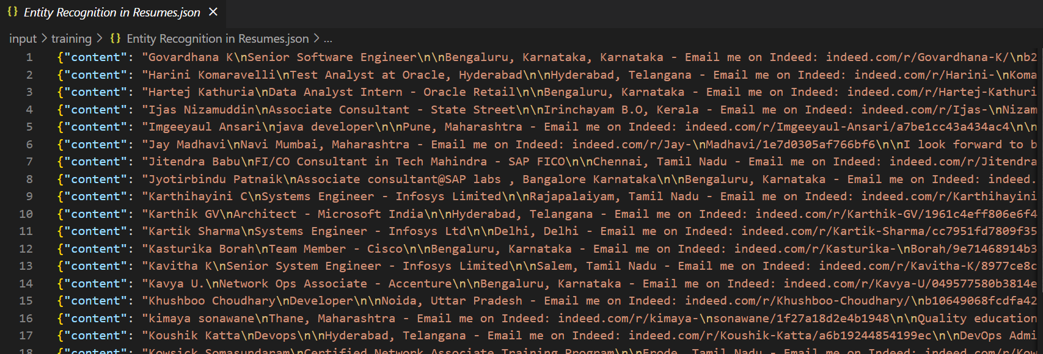
DATASET: POST ANNOTATION JSON
Post annotation, here is a glimpse of our training dataset:

Slide 9
MACHINE LEARNING PIPELINE

Slide 10

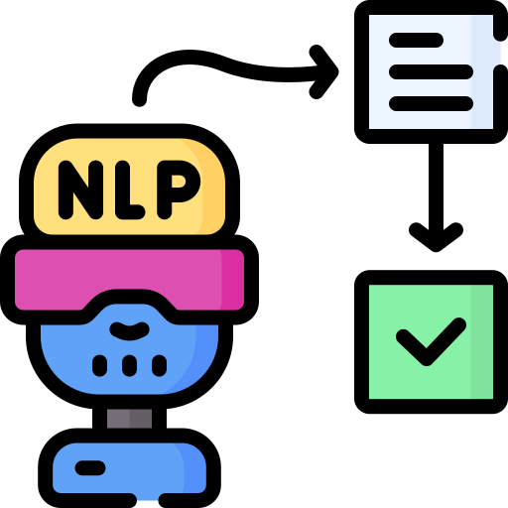




MACHINE LEARNING PIPELINE
Convert JSON Data to Spacy Format.
This module is used to read data from a JSON file containing labeled entities in text data and convert it into a format compatible with spaCy library. The function returns training data in the required format that can be used to train the NER (Named Entity Recognition) model.
Build SpaCy Model
This module is used to train a spaCy NER model using the training data obtained from step 1. The model is then returned.
Text Extractor
This module is used to extract text data from PDF files contained in a directory. It walks through the directory and its subdirectories and extracts text from all the PDF files found. The extracted text is then returned as a list.
Check Existing Model
This module is used to check if a previously trained model with a given name exists in the system. If it exists, it loads the model, else it returns None.
Predict Using SpaCy Model
This module is used to predict named entities using the spaCy model. It takes as input a directory path containing the resumes in PDF format, extracts text from these resumes using the text extractor module, and then predicts named entities.
Check Model Accuracy

Slide 11
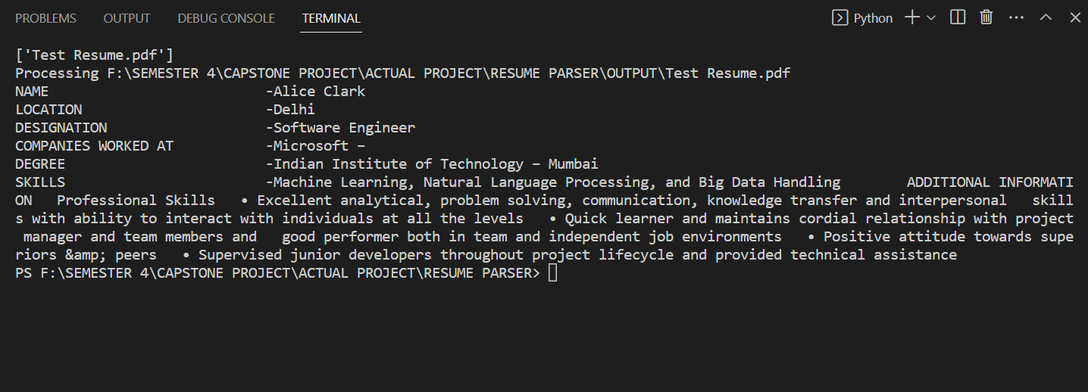
SAMPLE OUTPUT ON UNSEEN TEST DATA (1/2)

Slide 12
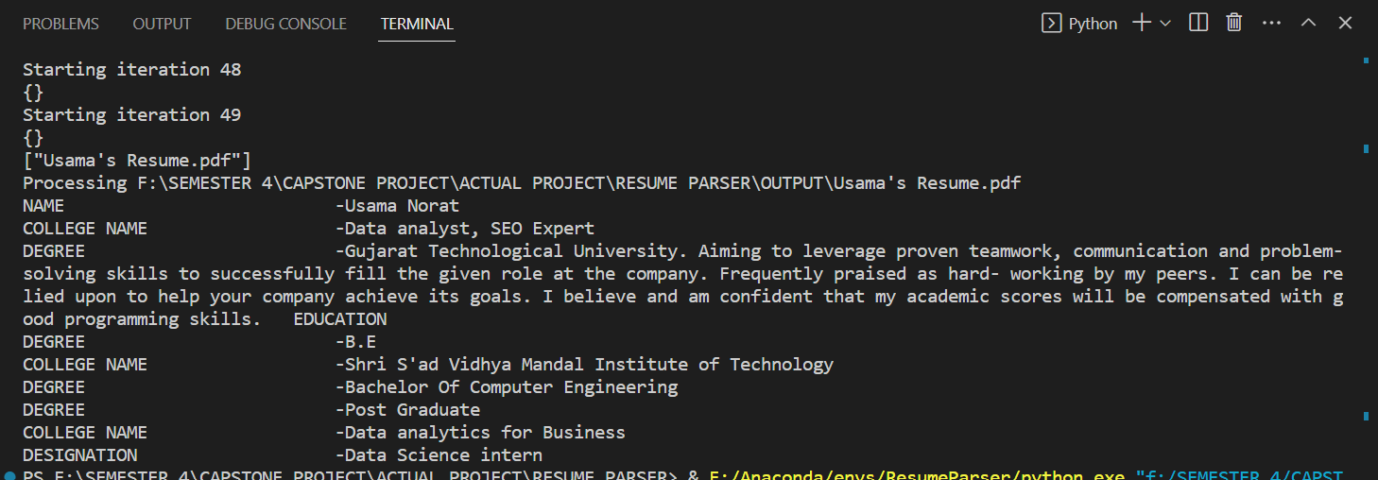
SAMPLE OUTPUT ON UNSEEN TEST DATA (2/2)

Slide 13




WAY FORWARD
CLOUD IMPLEMENTATION
WEB BASED APPLICATION
SIMPLE & INTUITIVE INTERFACE

Slide 14

Thank You!
Siddhartha Patra (0787887)
Usama Norat (079225)
Amir Dahya (0791252)

Slide 15
REFERENCES
https://analyticsindiamag.com/dataturks/
https://github.com/DataTurks-Engg/Entity-Recognition-In-Resumes-SpaCy
https://towardsdatascience.com/a-review-of-named-entity-recognition-ner-using-automatic-summarization-of-resumes-5248a75de175
https://medium.com/@debanjanmahata85/natural-language-processing-with-spacy-36b90b9afa3d
Special thanks to all the people who made and released these great resources for free:
Presentation template by SlidesCarnival
Photographs by Unsplash
Icons by Flaticon

